Slide 1
MINES-VIS
Week 5

Slide 2
Object Tracking
Topic Object tracking:
Color Filtering. Emphasize certain features.
cvtColor() -> from BGR to HSV
Inrange() -> max min
Contour finding
findContours()
Moments method
Topic Tracking and classifying multiple objects

Slide 3
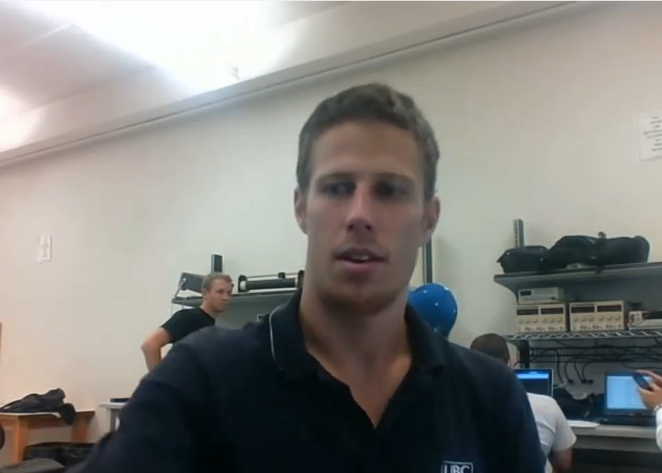
Object Tracking
Example: Tennisball Tracking Using OpenCV

Slide 4
Object Tracking
STEP 1
Convert image from BGR to HSV
(Blue, Green, Red) -> (Hue,Saturation, Value)
Why? Easy to filter color in HSV Colorspace.
STEP 2
Filter the Colors of interest between a MIN MAX threshold.
findContours() An OpenCv example
Finds contours in a binary image
Moments method
STEP 3
Morphological Operations
“Dilate” and “Erode”

Slide 5
Object Tracking
Why converting image from BGR to HSV?
Most everyone who's worked in any media for screen would (and should) be aware of the importance of the RGB value system.
While it is a concise system for describing colours, it is somewhat difficult for us to describe the nature of a colour by amounts of each channel by eye.
So rather than describing the additive blend of colours, we can describe a colour with HSV which breaks colour down into more simplistic characteristics. Let's look at each of these in detail:

Slide 6
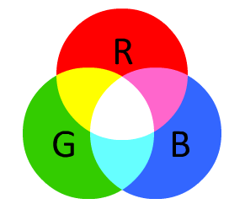
Object Tracking
RGB
Defined by listing how much red, green, and blue is contained in a single value. Being additive, the more of each colour that is added, the brighter (and closer to white) it becomes:

Slide 7
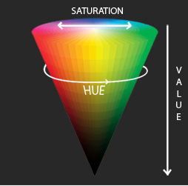
Object Tracking
In HSV, each "tint" of colour is assigned a particular number (the Hue). The "amount" of colour is assigned another number (the Saturation) and the brightness of the colour is assigned another number (the Intensity or Value).
This gives us the advantage of having a single number (hue) for the yellow ball despite multiple shades of yellow (all the way from dark yellow to a bright yellow)

Slide 8
Object Tracking
Morphological Operations
STEP 3
Dilate and Erode
DILATE
“dilates” white space. Making it larger
ERODE
“erodes” into white space. Making it smaller or non existent.

Slide 9
Object Tracking
FINAL STEP
FindContours
Input: binary image
Output: a vector of contours. The outline of all objects found in binary image.
“Moments” method.
Input: vector of contours.
Output: x,y coordinates of largest contour
Defined by its inner area

Slide 10
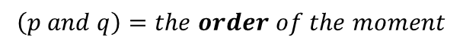
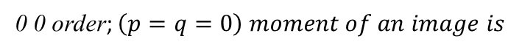
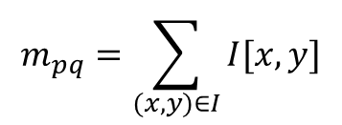
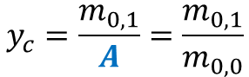
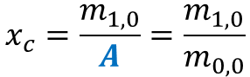
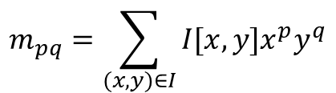
Object Tracking
“Moments”
an image moment is a certain particular weighted average (moment) of the image pixels, intensities, or a function of such moments, usually chosen to have some attractive property or interpretation.
$$m_{pq}=\sum_{(x,y)∈I}{I[x,y]x^{p}y^{q}}$$
which is the number of pixels or Area of the Object
Center of Gravity or Centroid
$$x_{c}=\frac{m_{1,0}}{A}=\frac{m_{1,0}}{m_{0,0}}$$
$$y_{c}=\frac{m_{0,1}}{A}=\frac{m_{0,1}}{m_{0,0}}$$

Slide 11
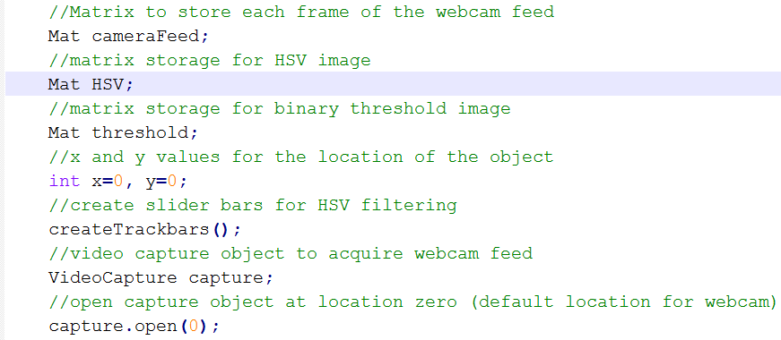
Object Tracking
Creating Matrices to store frames from the WebCam

Slide 12
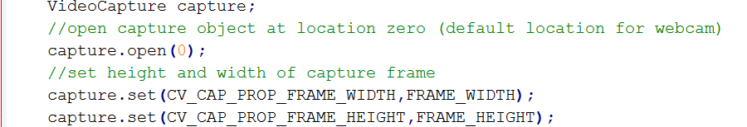
Object Tracking

Slide 13
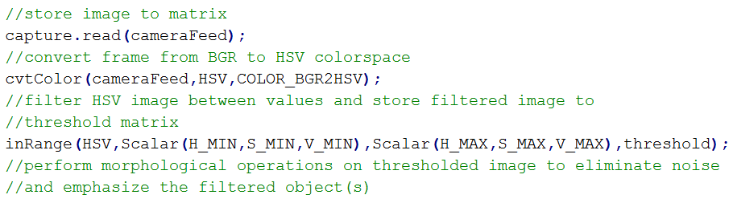
Object Tracking
See next slide

Slide 14
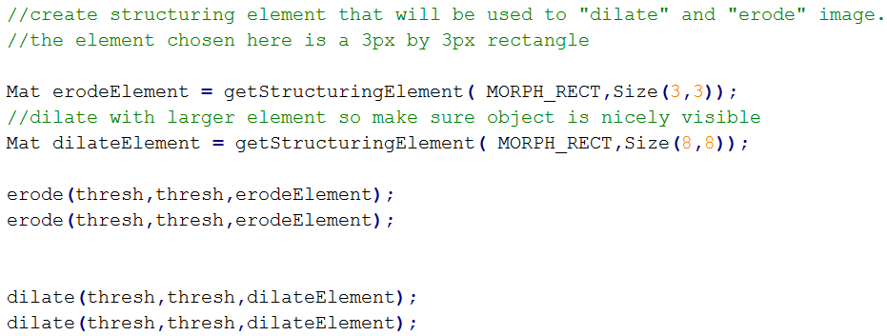
Object Tracking
Morphological Operations

Slide 15
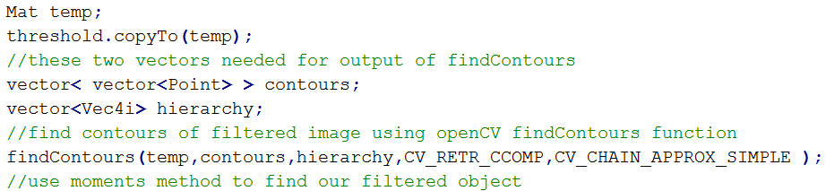
Object Tracking
Finds contours in a binary image
C++: void findContours(InputOutputArray image, OutputArrayOfArrays contours, OutputArray hierarchy, int mode, int method, Point offset=Point())

Slide 16
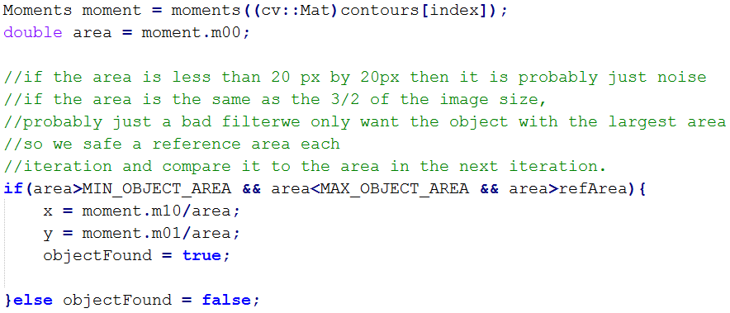
Object Tracking
“Moments”

Slide 17
Object Tracking
multiple objects
Topic Tracking and classifying multiple objects:
How Can We Classify Objects?
Use object-oriented programming approach
Each object has its own unique properties.
Look for objects with the same salient features and group them together.
How Can We Track Multiple Objects?
Push back similar objects into a C++ vector
Unpack the vector to display the found objects

Slide 18
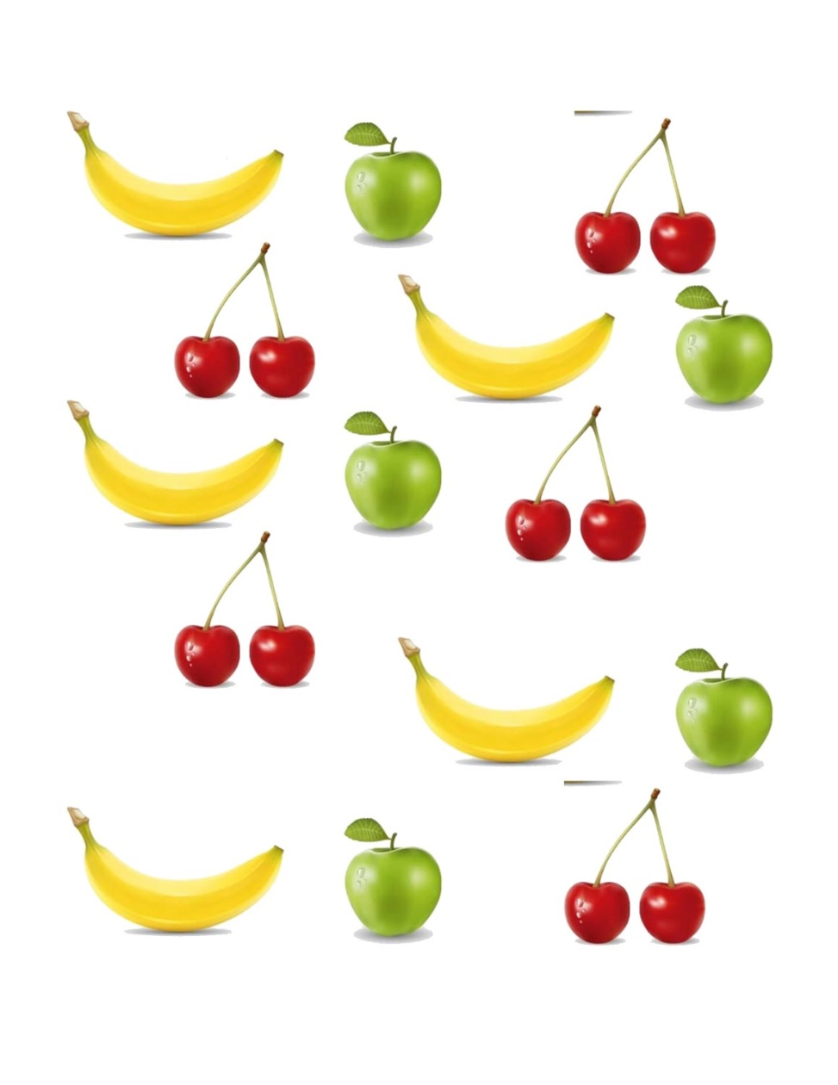
Object Tracking
multiple objects
Classify Objects

Slide 19

Object Tracking
multiple objects
+
x,y
+
x,y
+
x,y
+
x,y
+
x,y

Slide 20
Object Tracking
multiple objects
<
>

Slide 21
Object Tracking
multiple objects
<
>
Vector
Apples

Slide 22
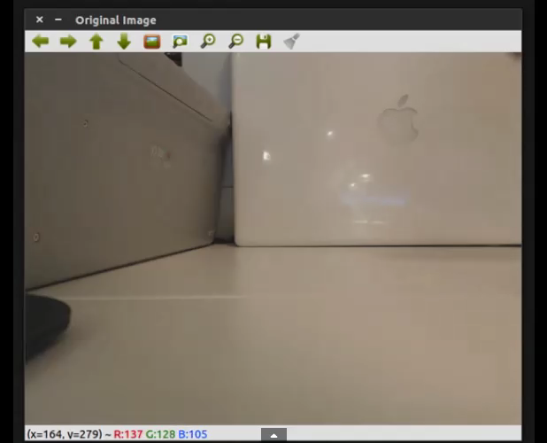
Object Tracking
Multiple objects
Example

Slide 23
The End

